Slide 1
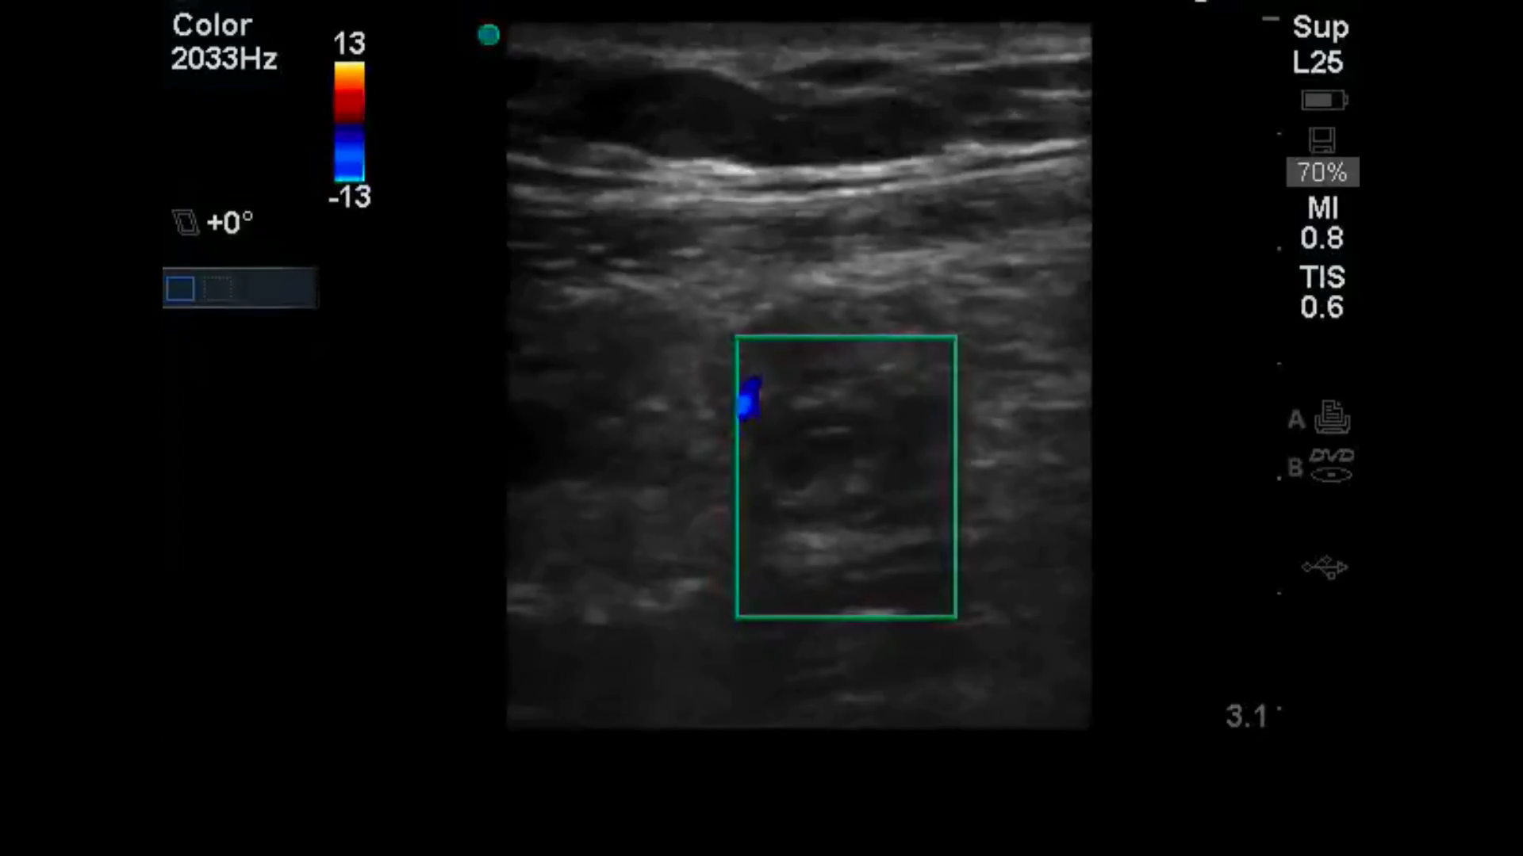
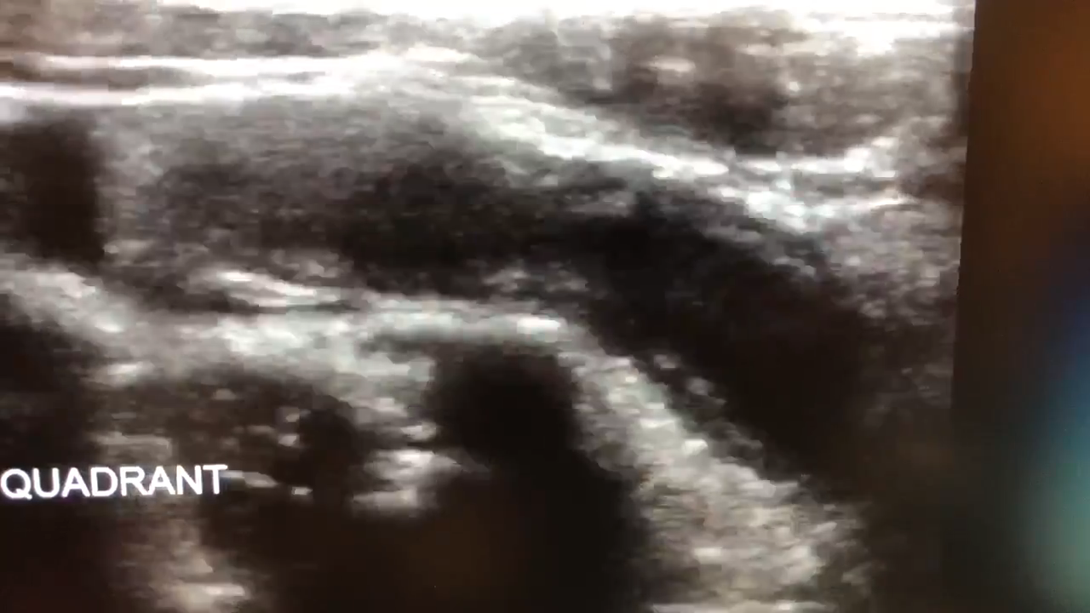
Appendicitis Point of Care Ultrasound

Slide 2
Outline
Indications and relative contraindications
Appendix anatomy including anatomical variants
Patient positioning and scanning technique
Clinical integration

Slide 3
The right patient for RLQ POCUS
Clinical concern for appendicitis (RLQ pain, fever, anorexia, nausea, vomiting)
Pain is thoughtfully managed
Immediate surgery is not a better option
You are not evaluating a large differential diagnosis (often the case in elderly pts)

Slide 4
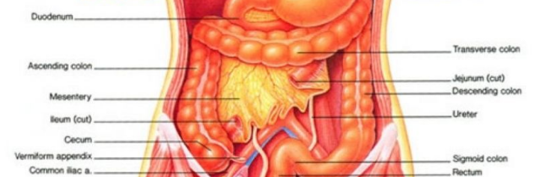
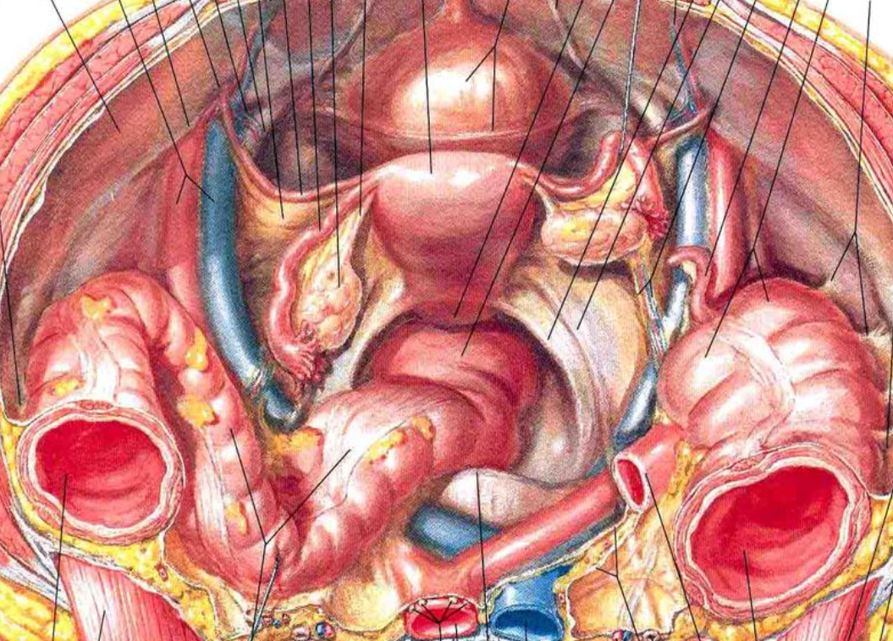
Appendix Anatomy
The appendix is located in the RLQ originating from the cecum
Commonly found overlying the iliac artery/vein

Slide 5
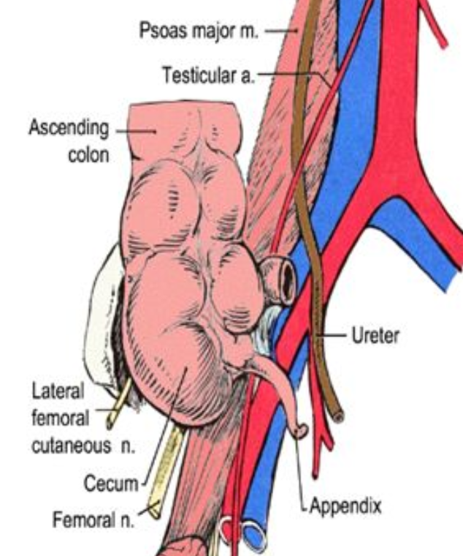
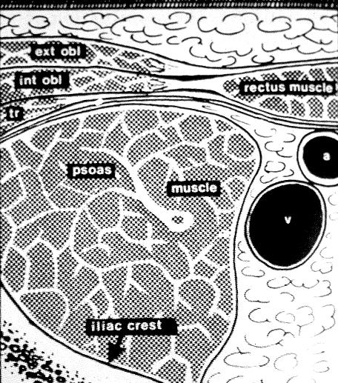
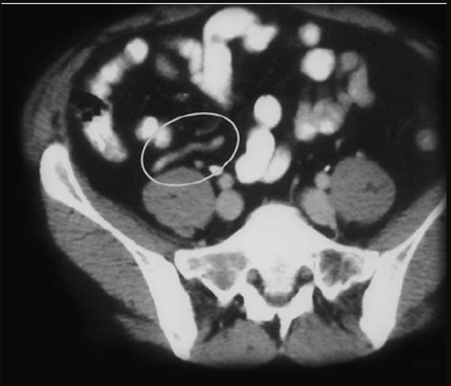
Appendix Anatomy
The appendix is located in the RLQ originating from the cecum
Commonly found overlying the iliac artery/vein AND psoas muscle

Slide 6
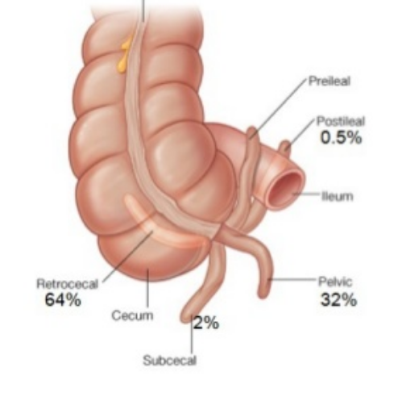
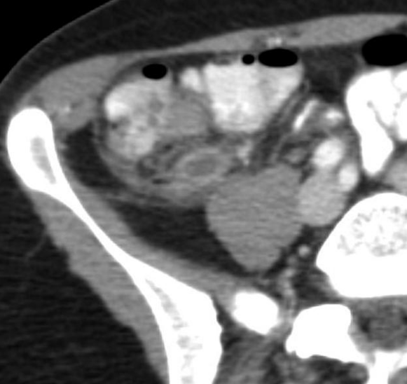
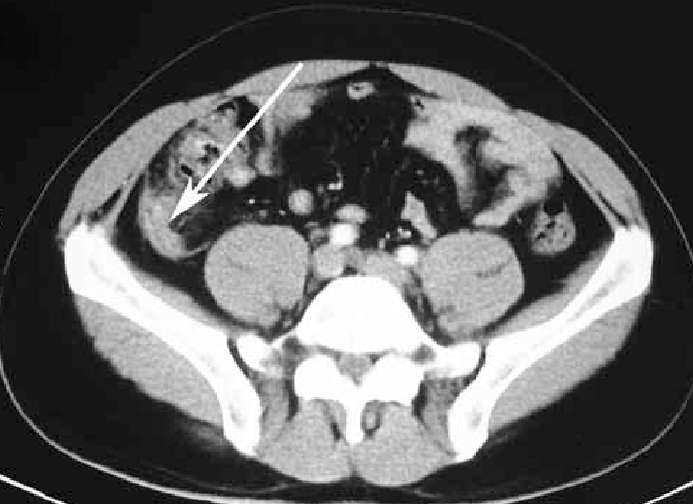
Appendix Anatomy Variants…
The appendix is actually only above the iliacs about 1/3 of the time
More likely, it is found behind the cecum, where there less well defined landmarks

Slide 7
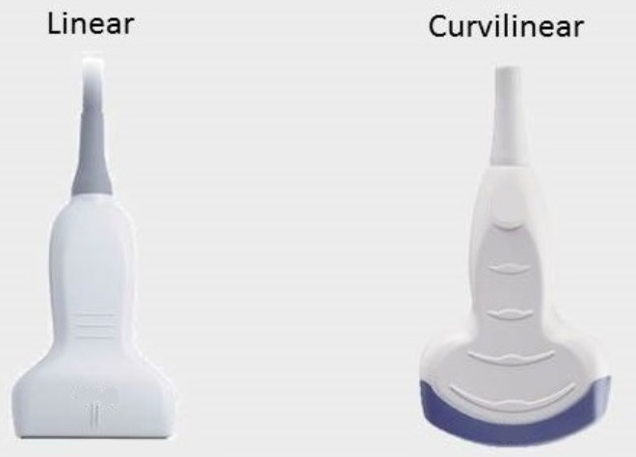
Probe Selection
Linear is good for image quality
Curvilinear is good for tissue penetration

Slide 8
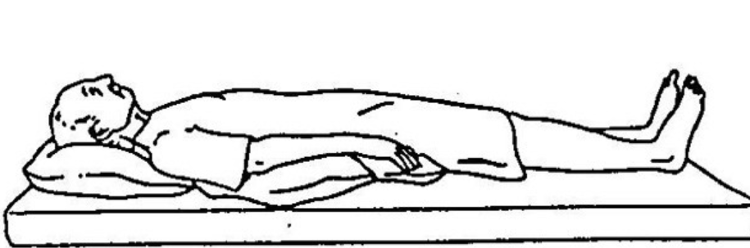
Patient Positioning
Scanning is done in the supine position
If tolerable, crossing the patient’s right leg over the left may help bring appendix more anterior

Slide 9
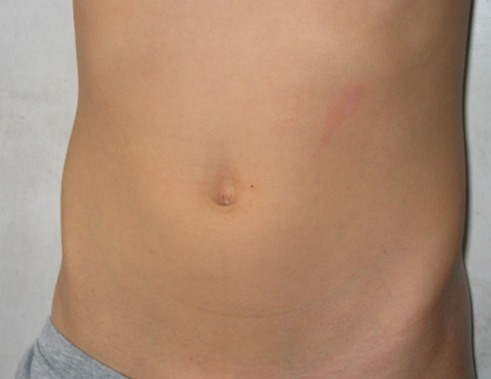
Scanning technique: point of most pain
Have the patient point to the location of most intense pain and put the probe there
Transverse view -> indicator to patient’s right
Sagittal -> indicator to patient’s head

Slide 10
Scanning technique: systematic
Search systematically for the appendix or landmarks
Appendix should be bounded by:
Iliac crest (lateral)
Iliac a/v (medial)
Psoas (posterior)
Keep the indicator up or to the right

Slide 11
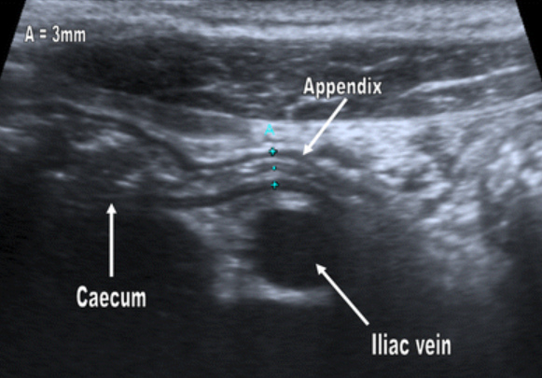
Ultrasound findings in normal appendix
Tubular structure (<6 mm diameter)
Compressible
Non-peristaltic
Proximal portion originates from the cecum

Slide 12
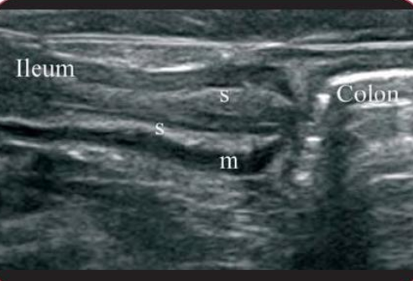
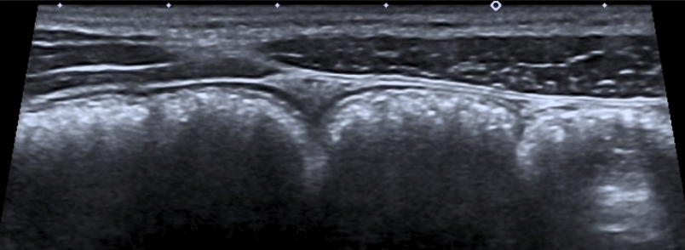
Ultrasound findings in normal appendix
VS Small bowel
Peristalsing with luminal contents
VS Large bowel (cecum)
Large stx with “dirty air pattern”

Slide 13
Ultrasound signs of acute appendicitis
Primary Criteria
Non-compressibility
Diameter >6 mm
Secondary Signs
Appendicolith – hyperechoic with posterior shadowing
Free fluid surrounding appendix
Mural hyperemia on color Doppler
Hyperechoic local mesenteric fat
Target sign
Hypoechoic fluid
Hyperechoic mucosa/submucosa
Hypoechoic muscularis

Slide 14
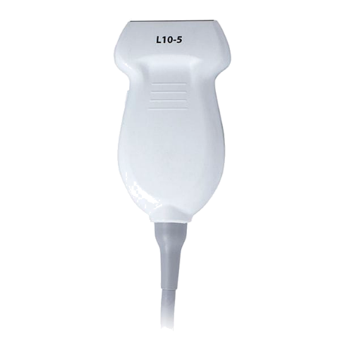
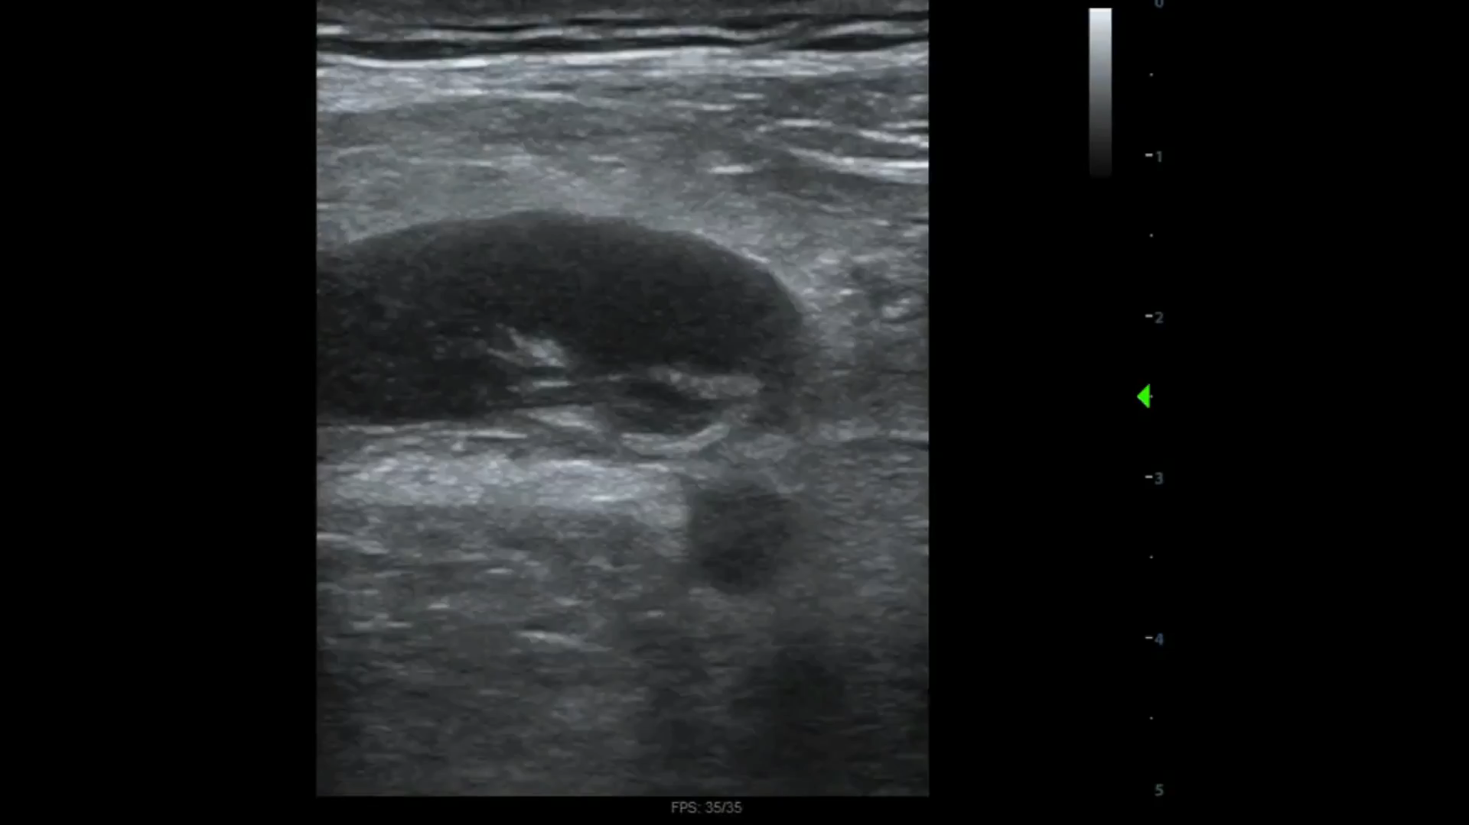
Acute perforated appendicitis
Findings:
Free fluid surrounding non-compressible tubular structure which overlies the iliac artery and psoas muscle
Mural hyperemia on Doppler

Slide 15
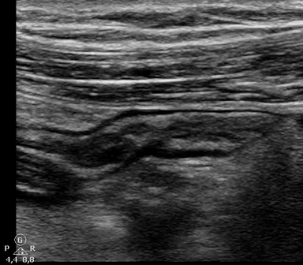
Acute Appendicitis
Findings: dilated non-compressible tubular structure overlying the iliac artery

Slide 16
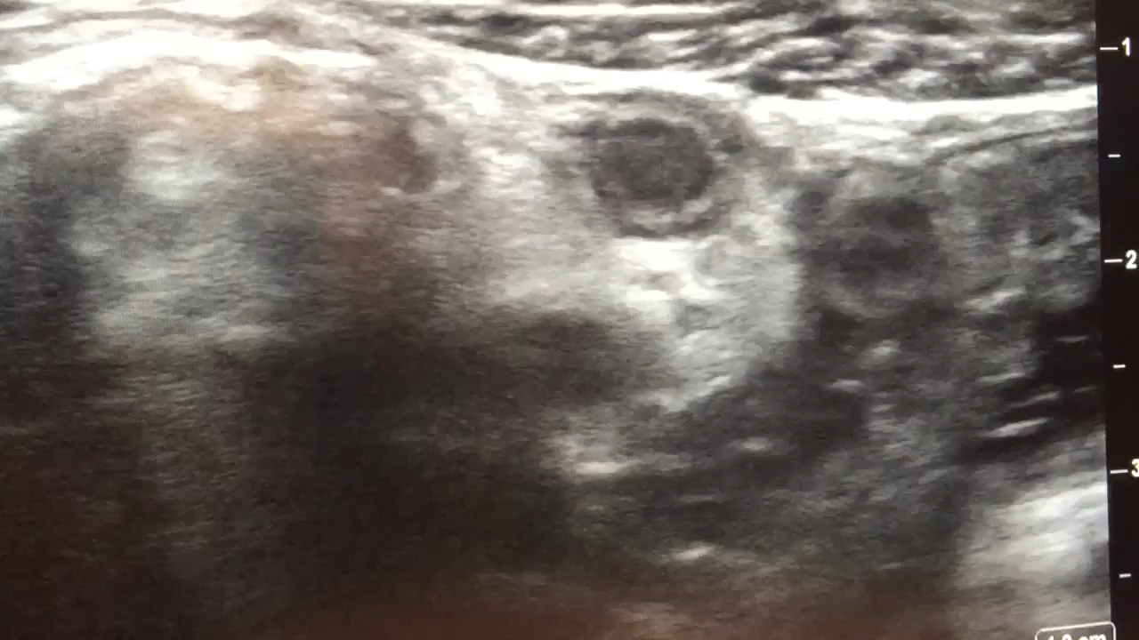
Acute Appendicitis
Findings: incompletely viewed dilated blind ending tubular structure with “target sign” and appendicolith

Slide 17
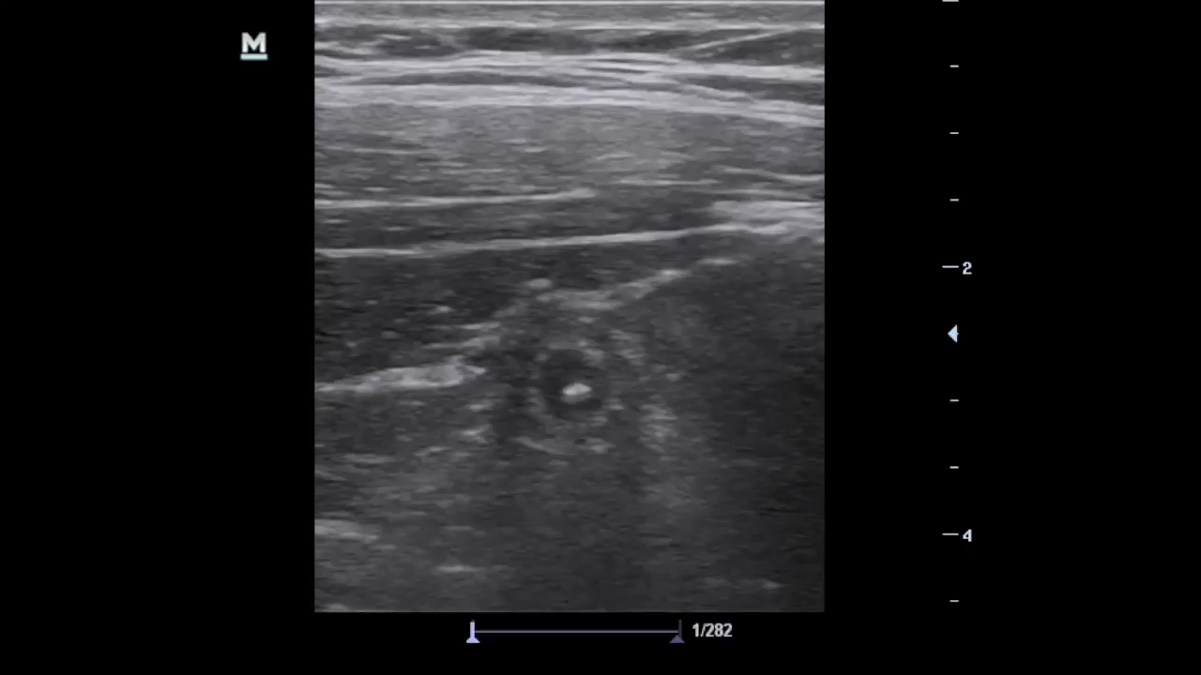
Acute Appendicitis
Findings: dilated non-compressible tubular structure demonstrating target sign and fecolith

Slide 18
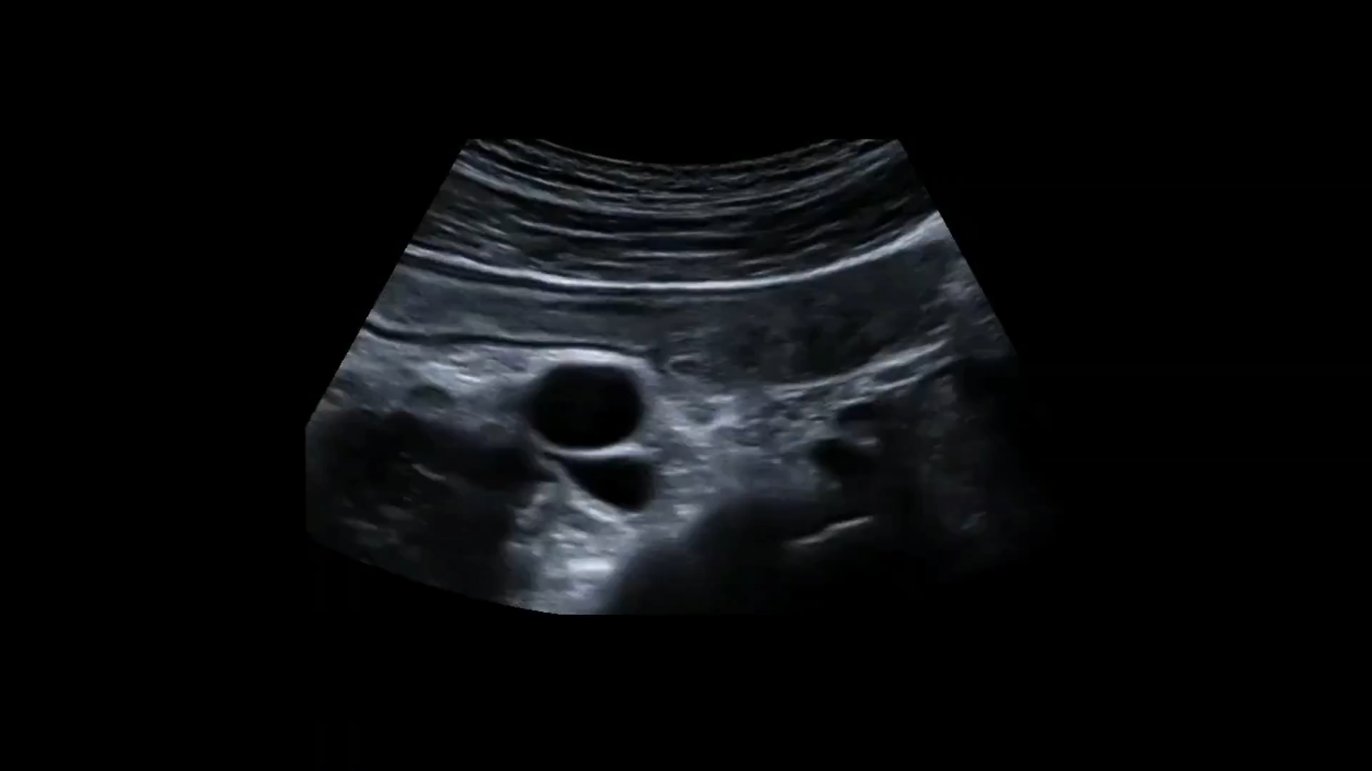
Acute Appendicitis
Findings: dilated blind ended tubular structure overlying iliac vessels and originating from the cecum with large fecolith

Slide 19
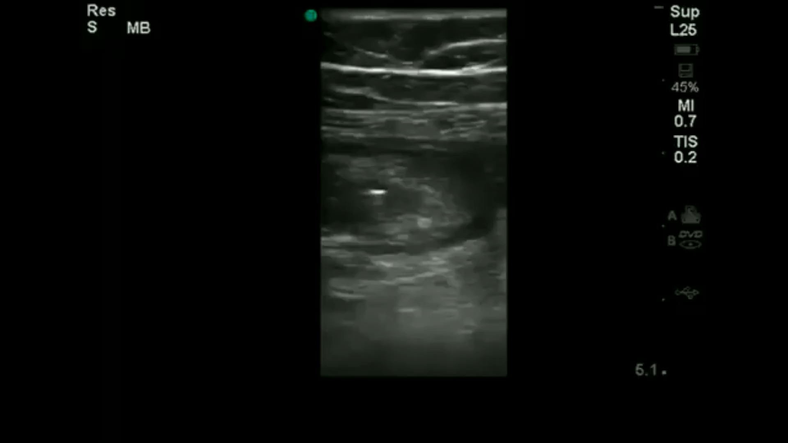
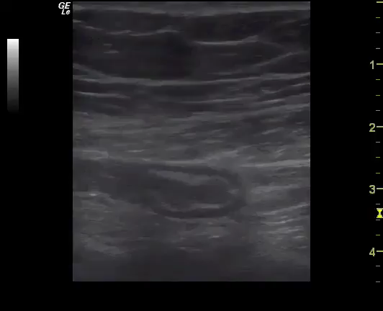
Acute Appendicitis
Findings: tip of appendix

Slide 20
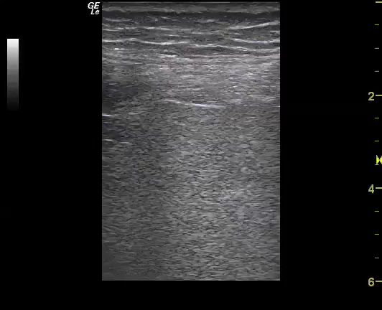
A-line pattern (abdomen)
Prominent A-line pattern in abdomen suggests intraabdominal free air

Slide 21
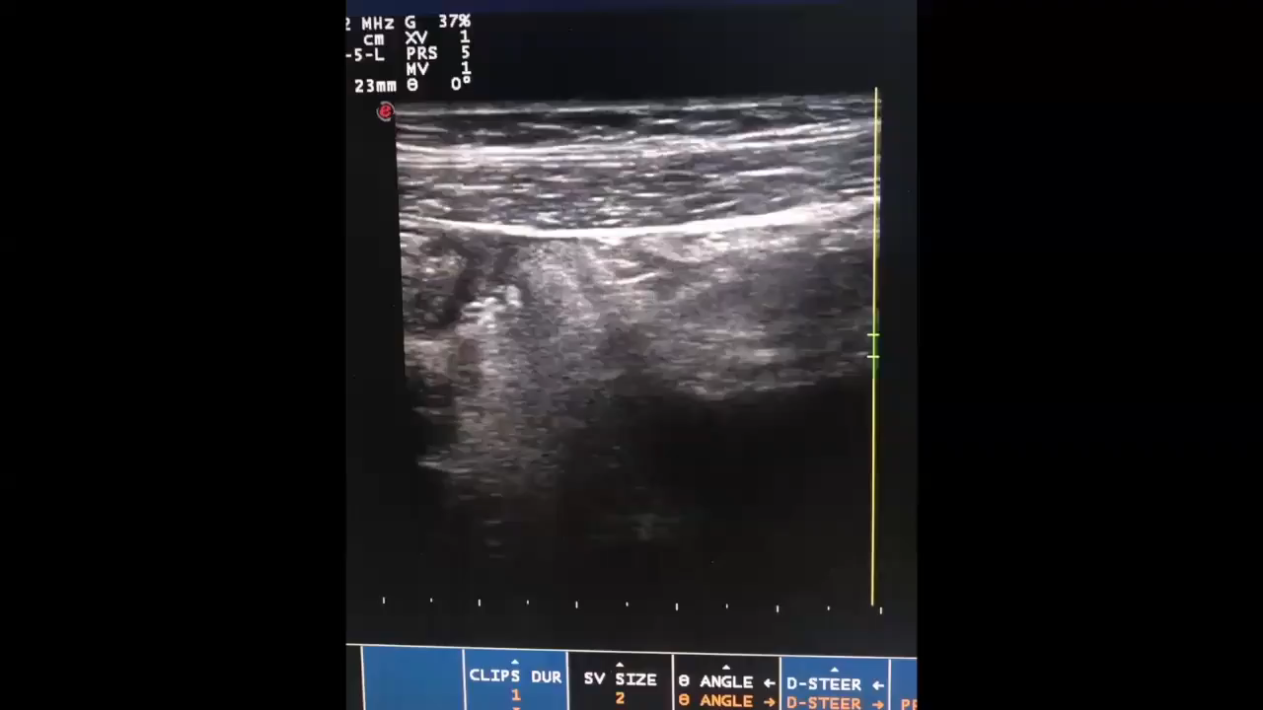
Acute Appendicitis
Findings: dilated blind ended tubular structure overlying iliac vessels with surrounding hyperechogenic fat

Slide 22
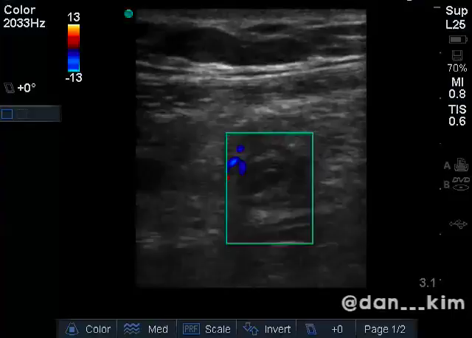
Acute Appendicitis
Findings: dilated tubular structure with hyperemia on Doppler
Target sign
Ring of fire sign

Slide 23
Interpreting Findings (when to CT)
Appendix Fully Visualized
High suspicion
Suspected
Low suspicion
Equivocal Findings
Appendix was not fully visualized and there are some secondary signs of appendicitis
Appendix NOT visualized
- Ongoing area of research
Likely does not need CT
Probably needs a CT
If few S/S: no CT
If many S/S: CT

Slide 24
Summary
Consider ultrasound as a first line diagnostic tool in select patients
Scan over point of most tenderness or systematically
Look for a blind ending, non-peristalsing, tubular structure
Non-compressibility and >6 mm width are diagnostic for appendicitis
Integrate test findings with overall clinical scenario

